Slide 1
Python project on OTP Verification System
Rakesh Chintareddy
S9633

Slide 2
Project Overview:
The OTP Verification System is a Python-based application that generates a
random 6-digit OTP, simulates sending it to a user's email, and verifies the OTP
entered by the user. This system ensures secure authentication by limiting the
number of attempts a user can make to enter the correct OTP.

Slide 3
Objective:
The primary objectives of the OTP Verification System are:
1.Generate a secure 6-digit OTP.
2.Simulate sending the OTP to the user's email.
3.Allow the user to input the OTP and verify it within 3 attempts.
4.Provide feedback on the OTP verification process, including the number of remaining attempts.

Slide 4
System Design:
The OTP Verification System follows these steps:
1.Generate OTP: A 6-digit random OTP is generated.
2.Simulate OTP Sending: The OTP is displayed to the console as a simulation of sending it to the user via email.
3.Verify OTP: The system prompts the user to enter the OTP and verifies whether it matches the generated OTP. The user has 3 attempts to enter the correct OTP.

Slide 5
System Design:
The OTP Verification System follows these steps:
1.Generate OTP: A 6-digit random OTP is generated.
2.Simulate OTP Sending: The OTP is displayed to the console as a simulation of sending it to the user via email.
3.Verify OTP: The system prompts the user to enter the OTP and verifies whether it matches the generated OTP. The user has 3 attempts to enter the correct OTP.

Slide 6
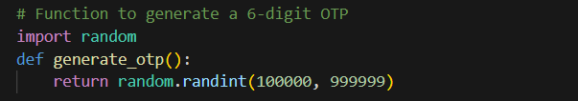
Code Explanation:
OTP Generation: The function generate_otp() generates a random integer between 100000 and 999999 using Python’s random.randint() function. This 6-digit number serves as the OTP.

Slide 7

Simulating OTP Sending: The function send_otp_simulated() is used to simulate the sending of the OTP. In a real-world scenario, this function would send the OTP via email or SMS, but here it simply prints the OTP to the console.

Slide 8
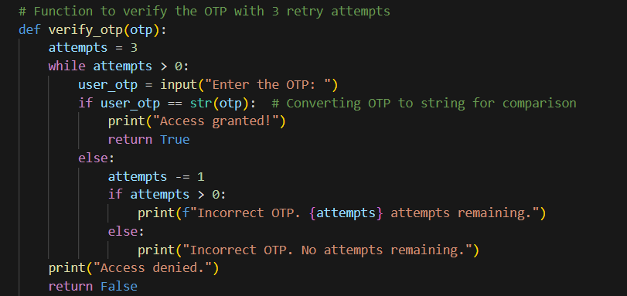
OTP Verification: The verify_otp() function compares the OTP entered by the user (user_otp) with the generated OTP. The user has 3 attempts to enter the correct OTP. If the user enters the correct OTP, the access is granted; otherwise, after 3 incorrect attempts, access is denied.

Slide 9
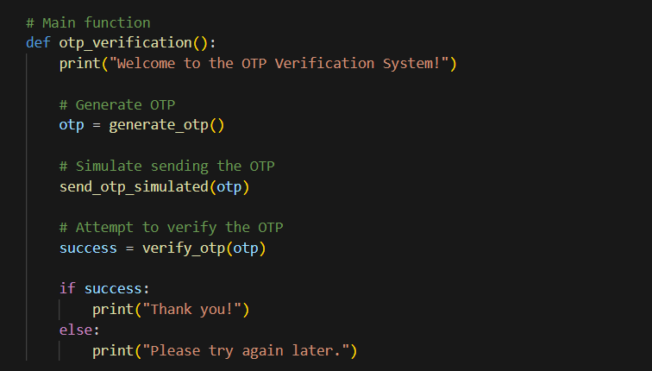
Main Function: The otp_verification() function orchestrates the entire flow: generating the OTP, simulating its sending, and verifying the OTP entered by the user.

Slide 10

Running the System: The system runs by calling the otp_verification() function, which triggers the OTP generation, sending, and verification process.

Slide 11
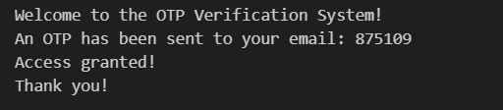
Sample Output:
The following is an example of how the program behaves:

Slide 12
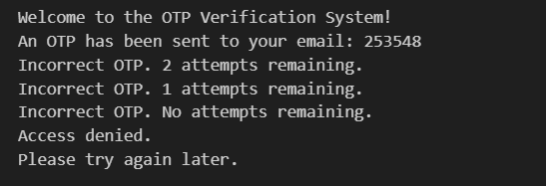
If the user enters an incorrect OTP all three times:

Slide 13
Features:
Random OTP Generation: A 6-digit OTP is generated randomly for each verification attempt.
OTP Sending Simulation: The OTP is simulated to be sent to the user's email (printed to the console).
Multiple Attempts: The user has up to 3 attempts to enter the correct OTP before access is denied.
User Feedback: Clear messages are provided to inform the user of the number of remaining attempts and the result of the OTP verification.

Slide 14
Conclusion:
This OTP Verification System provides a simple but effective demonstration of how OTPs can be used for secure user authentication. The system is easy to understand and provides a foundation for more complex verification systems, including those integrated with actual email or SMS services.

Slide 15
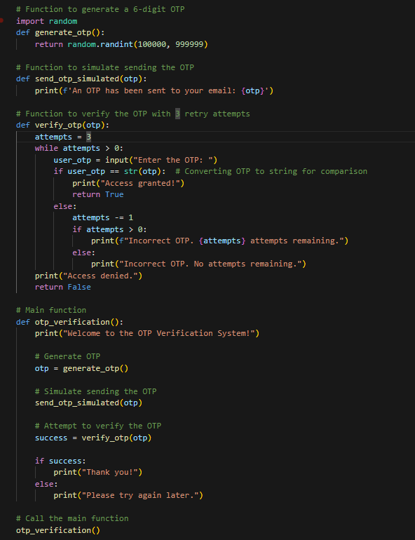

Slide 16
Thank YOU
Rakesh Chintareddy
S9633

